Slide 1
K- Nearest Neighbors

Slide 2
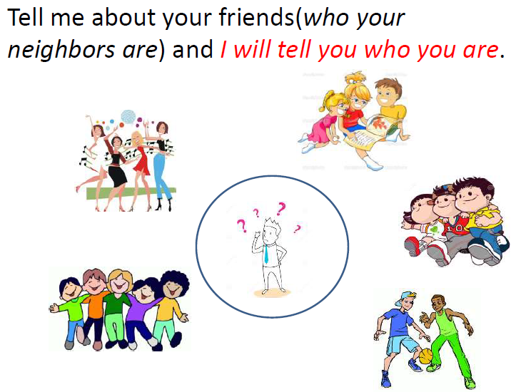
Simple Analogy..

Slide 3
KNN – Different names
K-Nearest Neighbors
Memory-Based Reasoning
Example-Based Reasoning
Instance-Based Learning
Lazy Learning

Slide 4
What is KNN?
A powerful classification algorithm used in pattern recognition.
K nearest neighbors stores all available cases and classifies new cases based on a similarity measure(e.g distance function)
One of the top data mining algorithms used today.
A non-parametric lazy learning algorithm (An Instance based Learning method).

Slide 5
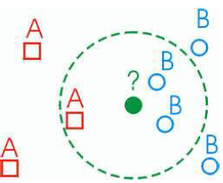
KNN: Classification Approach
An object (a new instance) is classified by a majority votes for its neighbor classes.
The object is assigned to the most common class amongst its K nearest neighbors.(measured by a distant function )

Slide 6
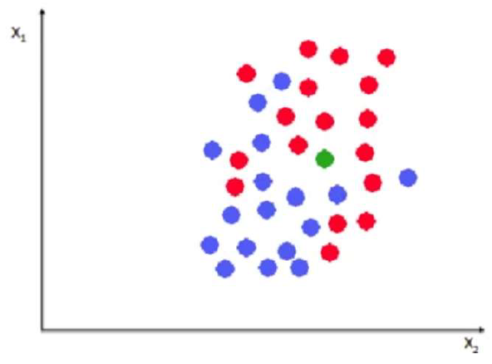

Slide 7
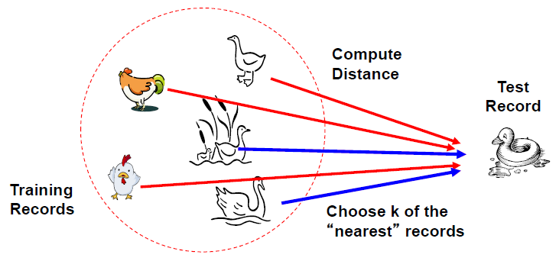
Distance Measure

Slide 8
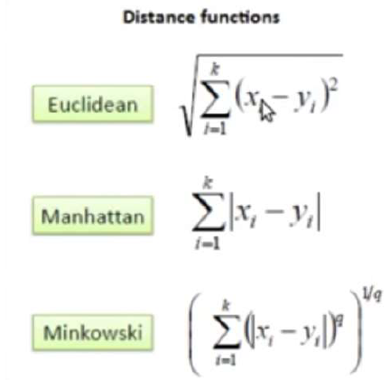
Distance measure for Continuous Variables

Slide 9
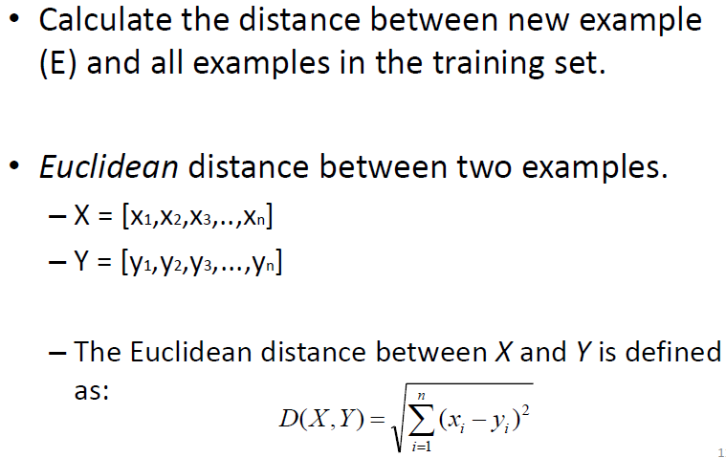
Distance Between Neighbors

Slide 10
K-Nearest Neighbor Algorithm
All the instances correspond to points in an n-dimensional feature space.
Each instance is represented with a set of numerical attributes.
Each of the training data consists of a set of vectors and a class label associated with each vector.
Classification is done by comparing feature vectors of different K nearest points.
Select the K-nearest examples to E in the training set.
Assign E to the most common class among its K-nearest
neighbors.

Slide 11
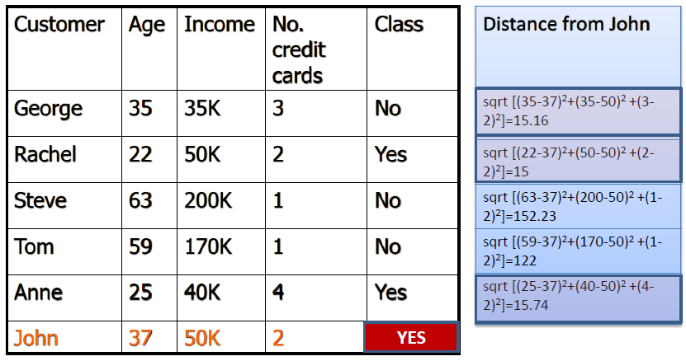
3-KNN: Example

Slide 12
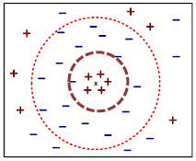
How to choose K?
If K is too small it is sensitive to noise points.
Larger K works well. But too large K may include majority points from other classes.
Rule of thumb is K < sqrt(n), n is number of examples.

Slide 13
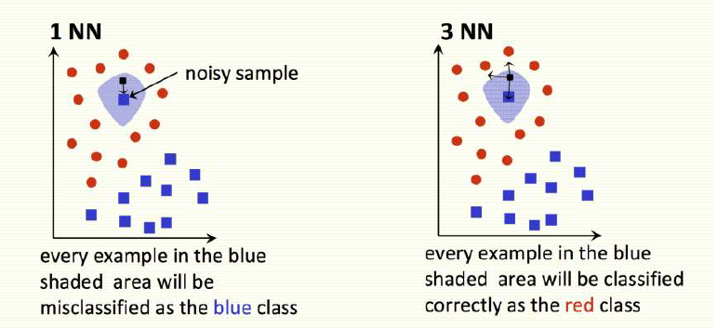

Slide 14
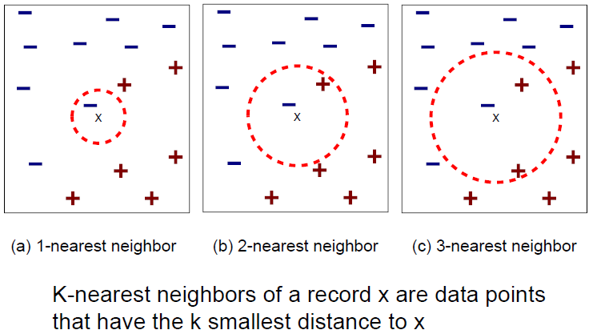

Slide 15
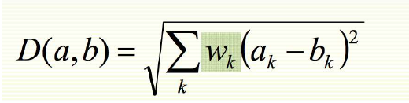
KNN Feature Weighting
Scale each feature by its importance for classification
Can use our prior knowledge about which features are more important
Can learn the weights wk using cross‐validation

Slide 16
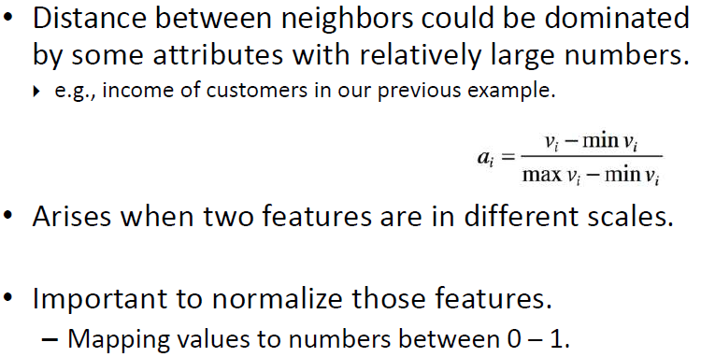
Feature Normalization

Slide 17
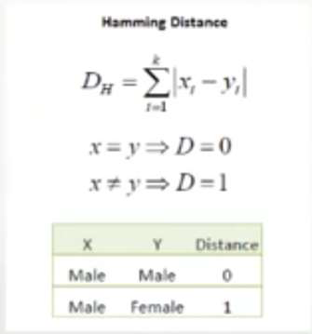
Nominal/Categorical Data
Distance works naturally with numerical attributes.
Binary value categorical data attributes can be regarded as 1 or 0.

Slide 18
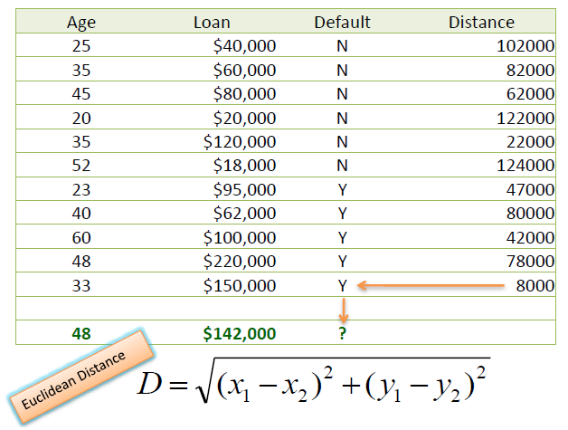
KNN Classification – Distance

Slide 19
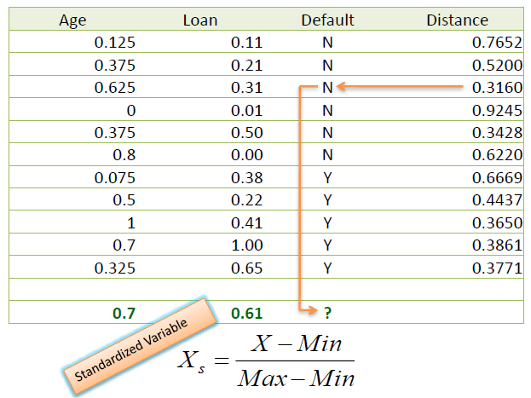
KNN Classification – Standardized Distance

Slide 20
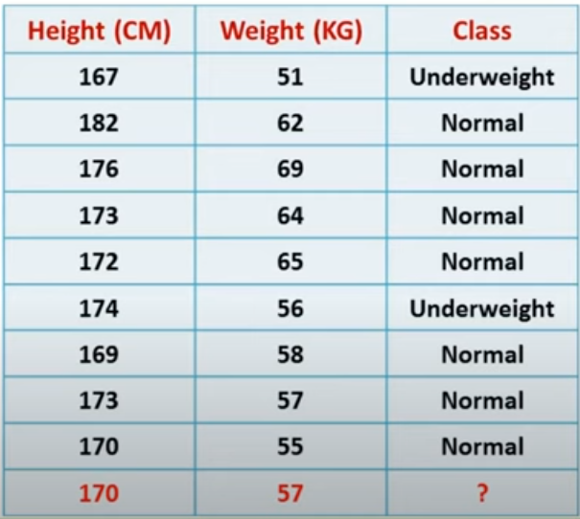
Example
Dataset

Slide 21
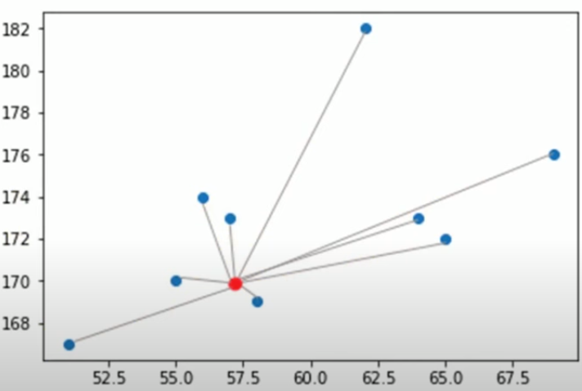

Slide 22
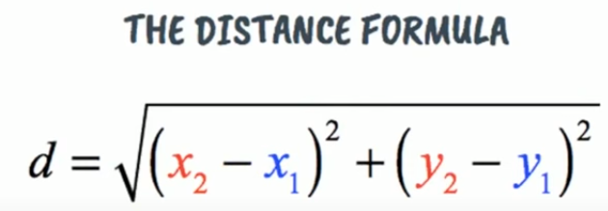

Slide 23
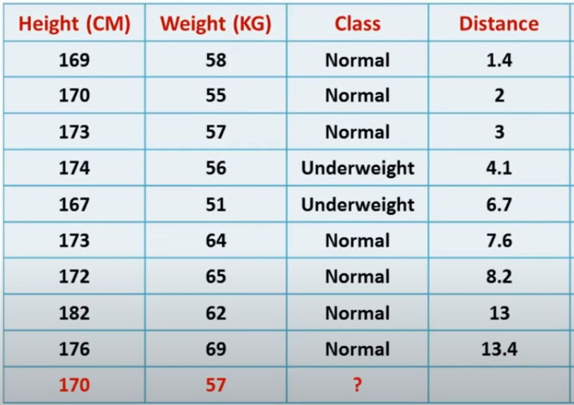

Slide 24
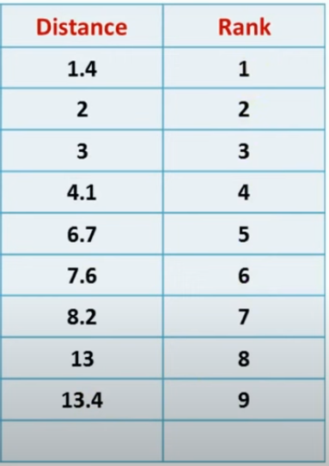

Slide 25
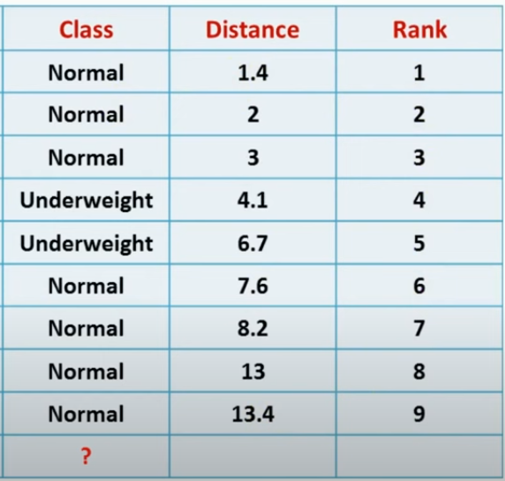





Slide 26
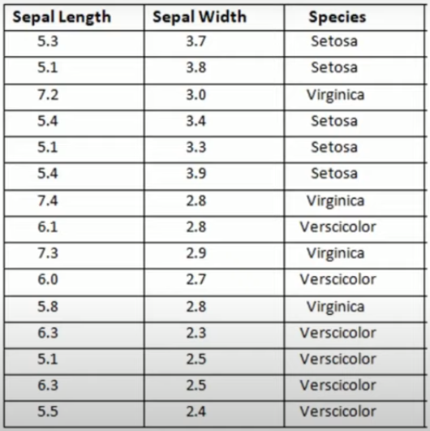
Example
Dataset

Slide 27
Classify the new example

Slide 28
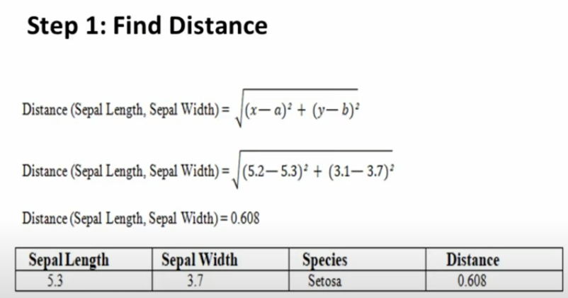

Slide 29
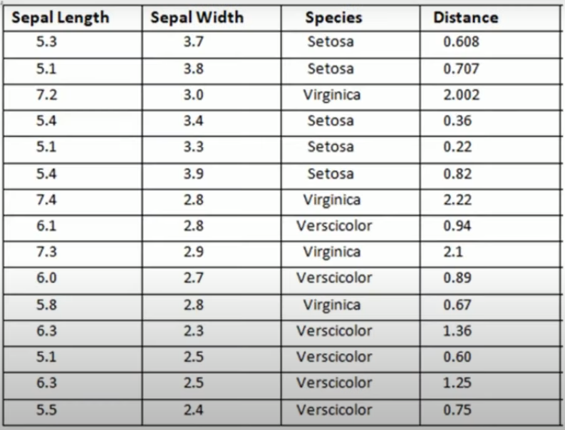
Distance to each training example

Slide 30
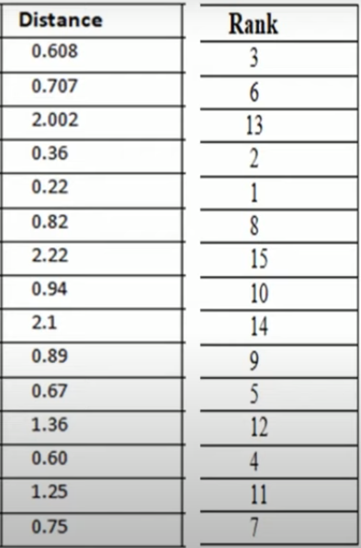
2. Find Rank

Slide 31
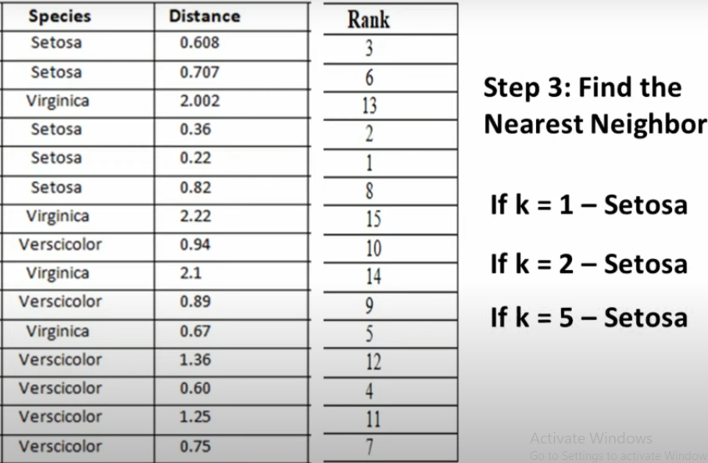

Slide 32
Strengths of KNN
Very simple and intuitive.
Can be applied to the data from any distribution.
Good classification if the number of samples is large enough.

Slide 33
Weaknesses of KNN
Takes more time to classify a new example.
Need to calculate and compare distance from new example to all other examples.
Choosing k may be tricky.
Need large number of samples for accuracy.

